Slide 1
View of Data Types of DBMS
A Comparative Analysis

Slide 2
View of Data
Data Abstraction
1.1. Internal View
1.2. Conceptual/Global View
1.3. External/User View
Database Schema/Intention
Instance / State / Occurrence / Extension / Snapshot
Mapping
Data Independence
5.1. Logical Data Independence
5.2. Physical Data Independence
Data Models
6.1. File Processing/Based or Primitive
6.2. Conceptual/High Level – ER & EER Diagrams
6.3. Logical/Record based/Representational/Implementational
6.3.1. Hierarchical (Legacy DBMS)
6.3.2. Network (Legacy DBMS)
6.3.3. Relational (Traditional DBMS)
6.3.4. Object Relational/Extended Relational
6.3.5. Object Oriented
6.4. Physical/Low-level

Slide 3
Types of DBMS
According to Data Model
1.1. Hierarchical DBMS (HDBMS) – Tree – IBS
1.2. Network DBMS (NDBMS) – Graph – IDS, IDMS
1.3. Relational DBMS (RDBMS) – Table – MySQL, MS SQL Server, Oracle
1.4. Object Relational/Extended Relational – Object + Table – Oracle, Sybase, Informix,
1.5. Object Oriented DBMS – Object – db4o
According to Access Path
2.1. OLTP
2.2. OLAP
According to Usage
3.1. Commercial
3.2. Temporary
3.3. Real time
3.4. Multimedia
3.5. Geographical Information System
According to Users
4.1. Single User – MS Access
4.2. Multi User

Slide 4
Structured Database
A structured database organizes data into a predefined format, typically in rows and columns. This format ensures that the data is easily searchable and can be efficiently managed using relational database management systems (RDBMS).
Features:
Data Format: Organized into tables with rows and columns (e.g., spreadsheets).
Schema: Fixed schema defines the structure of the database (e.g., column names, data types).
Query Language: Uses SQL (Structured Query Language) for data manipulation and retrieval.
Examples: MySQL, PostgreSQL, Oracle Database, Microsoft SQL Server.
Advantages:
Efficient Querying: Optimized for fast querying with SQL.
Data Consistency: Enforces data integrity and relationships.
Scalability: Vertical scaling is straightforward (adding more resources to a single machine).
Security: Built-in features like user roles, access control, and encryption.
Use Cases:
Financial systems.
Customer Relationship Management (CRM) systems.
Inventory management systems.

Slide 5
Non-Structured Database:
A non-structured database (also called a NoSQL database) stores data in a flexible and unstructured format, such as documents, key-value pairs, or graphs. It does not rely on predefined schemas, allowing for greater flexibility.
Features:
Data Format: Data can be stored as JSON, XML, key-value pairs, or graphs.
Schema: Schema-less or dynamic schema for flexibility.
Query Language: May use APIs, query languages like CQL (Cassandra Query Language), or built-in commands (not SQL).
Examples: MongoDB, Cassandra, Couchbase, Neo4j, Redis.
Advantages:
Scalability: Horizontal scaling is easier (adding more machines to distribute the workload).
Flexibility: Can handle semi-structured, unstructured, or hierarchical data.
Performance: Optimized for handling large datasets and high-velocity data.
Support for Big Data: Suitable for handling high volumes of diverse data.
Use Cases:
Social media platforms.
Real-time analytics.
Internet of Things (IoT) applications.
Content management systems.

Slide 6
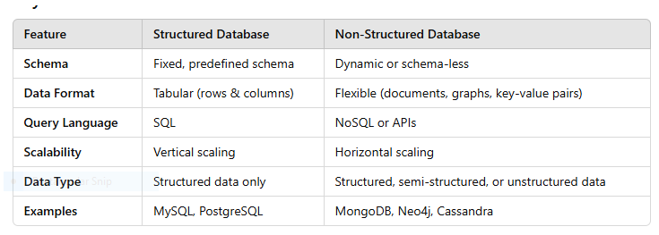
Structured vs Un/Non-Structured

Slide 7
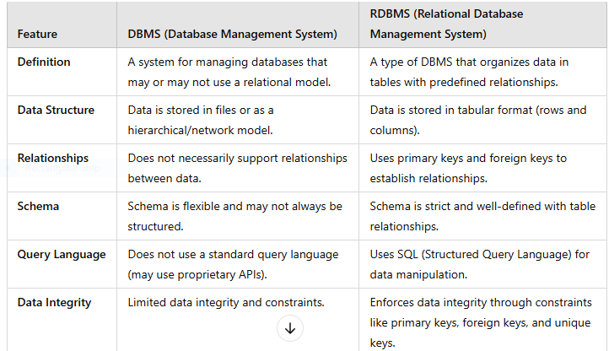
DBMS vs RDBMS

Slide 8
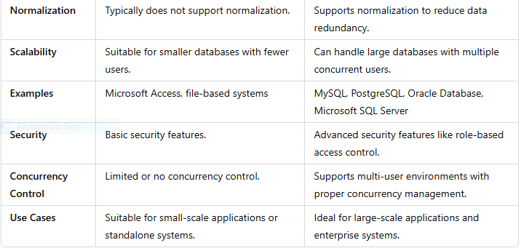
Contd…

Slide 9
Minutes
Basic Terminologies – Data, Base, Database, Information, DBMS, DBS.
Traditional File Based System vs DBMS – Merits & Demerits.
Construction of DBS
DBS Architecture – Single Tier, Two Tier, Three Tier; ANSI (American National Standard Institute) / SPARC (Standards Planning And Requirements Committee).
Components/Organization of DBS – H/W; S/W:OS, DBMS; Data-Operational, Meta; Procedure; People/user-Database Users; Database Languages.
Structure of DBS
Functions of DBMS
View of Data
Types of DBMS

